Slide 1

Team 21 Question Bank Service
Team Members:
Ansh Chablani 2022111031
Divyarajsinh Mahida 2022101085
Siddharth Singh 2021113001
Shreyas Badami 2021113003
Client: Virtual Labs

Slide 2
Problem Statement
Our project is to create a question bank service for our client Virtual Labs.
This involves creating a web application that enables us to add questions, view questions and download them.
This is provided with an API that users can use to fetch and add the questions after authentication.
We would also provide validators as per the client’s needs.

Slide 3
Approach to solve the problem
.
To solve the problem, we divided the problem into five components –
Question Retrieval Component
Question Display Component
Download Component
Add Question Component
Authentication Component

Slide 4
Processes we followed
1-week sprints.
Whole process in each sprint.
Meeting with the client after each week.
Integration continuously
Deployment continuously after the release of the alpha version.
Special meetings were arranged to clear questions about key implementations if and when needed.

Slide 5
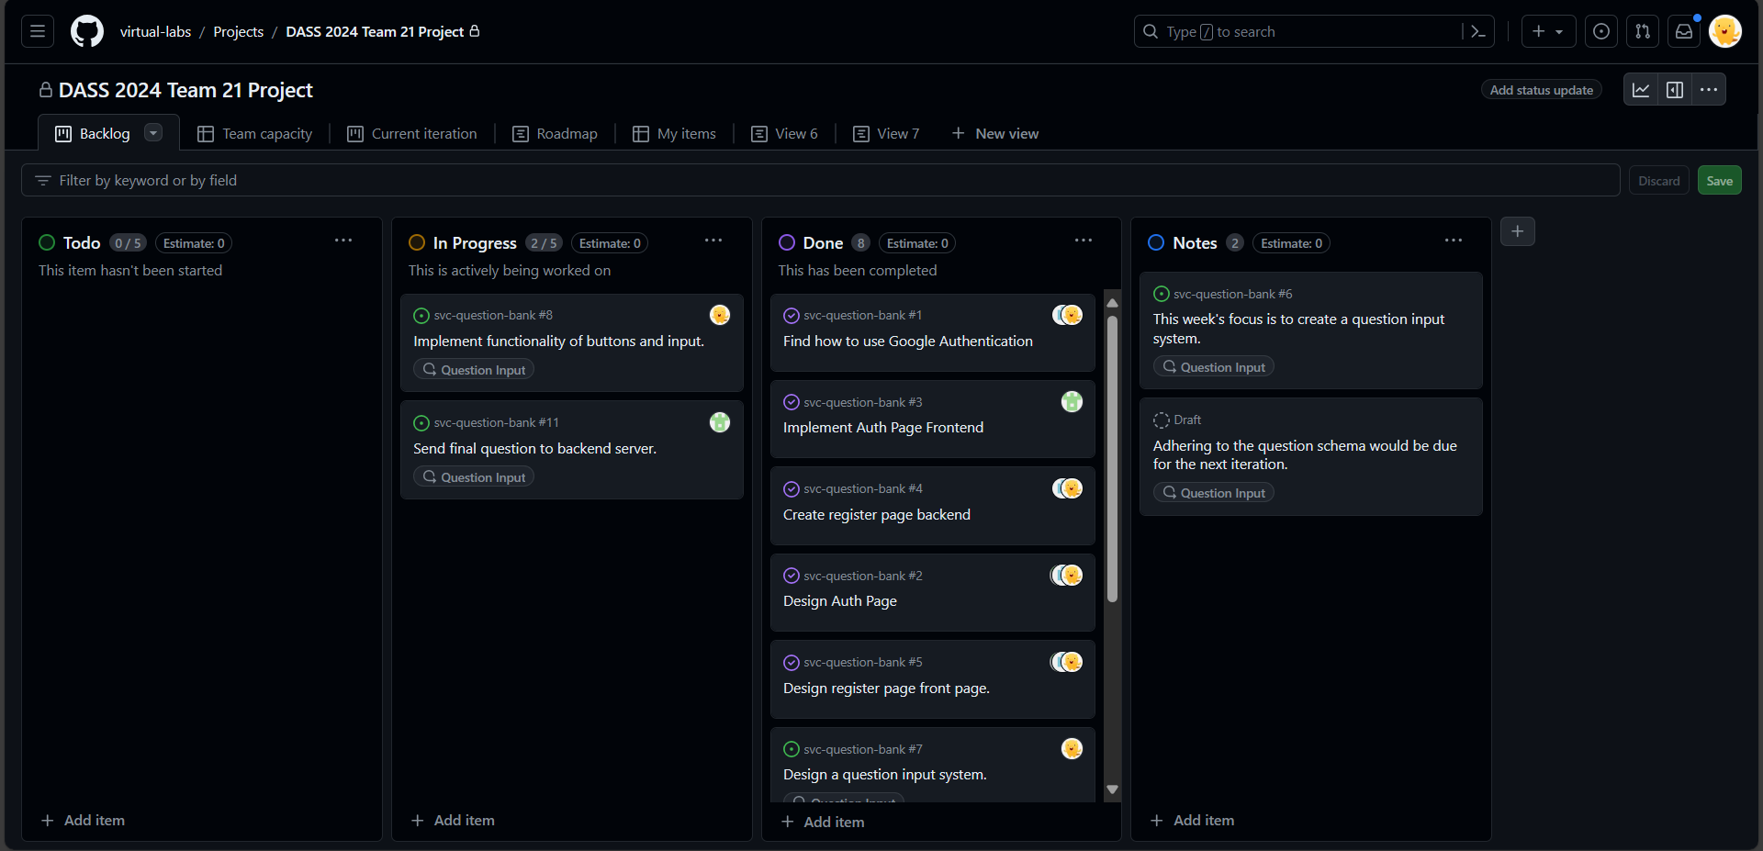
GitHub Issue Tracker
1-week sprints.
Whole process in each sprint.
Meeting with the client after each week.
Integration continuously
Deployment continuously after the release of the alpha version.
Special meetings were arranged to clear questions about key implementations if and when needed.

Slide 6
FEATURES

Slide 7
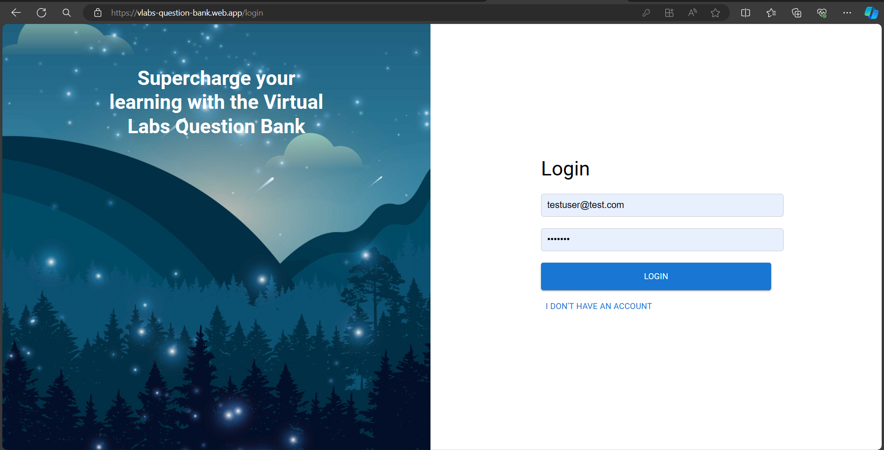
AUTHENTICATION

Slide 8
Authentication
Our authentication system provides login retention. If a user chooses to save their details, they would be logged in again automatically after reopening the browser.
Security has been ensured by several methods: 1. Disabling other buttons when the user is being logged in to avoid user session manipulation.
2. Denying any access to users who are not logged in.

Slide 9
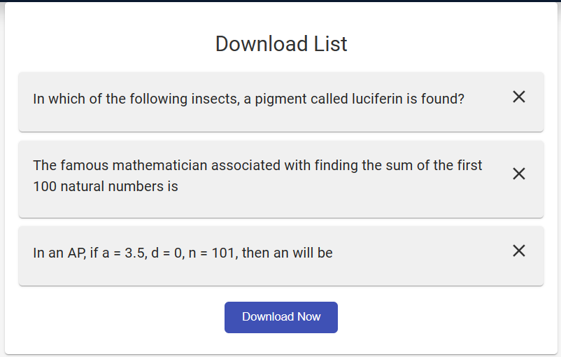
Download List Page

Slide 10
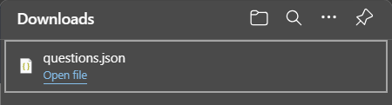
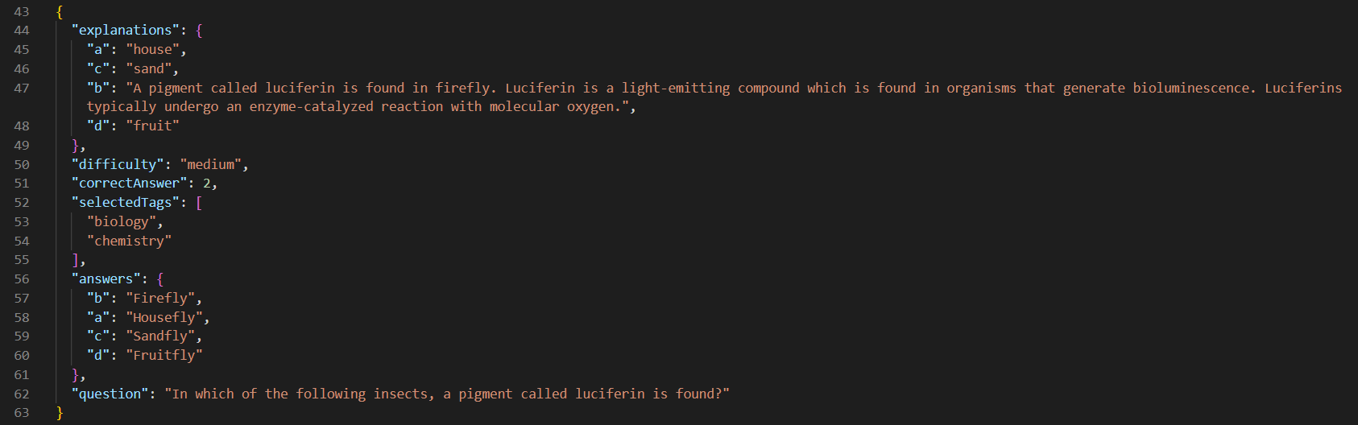
The question’s JSON file gets downloaded.

Slide 11
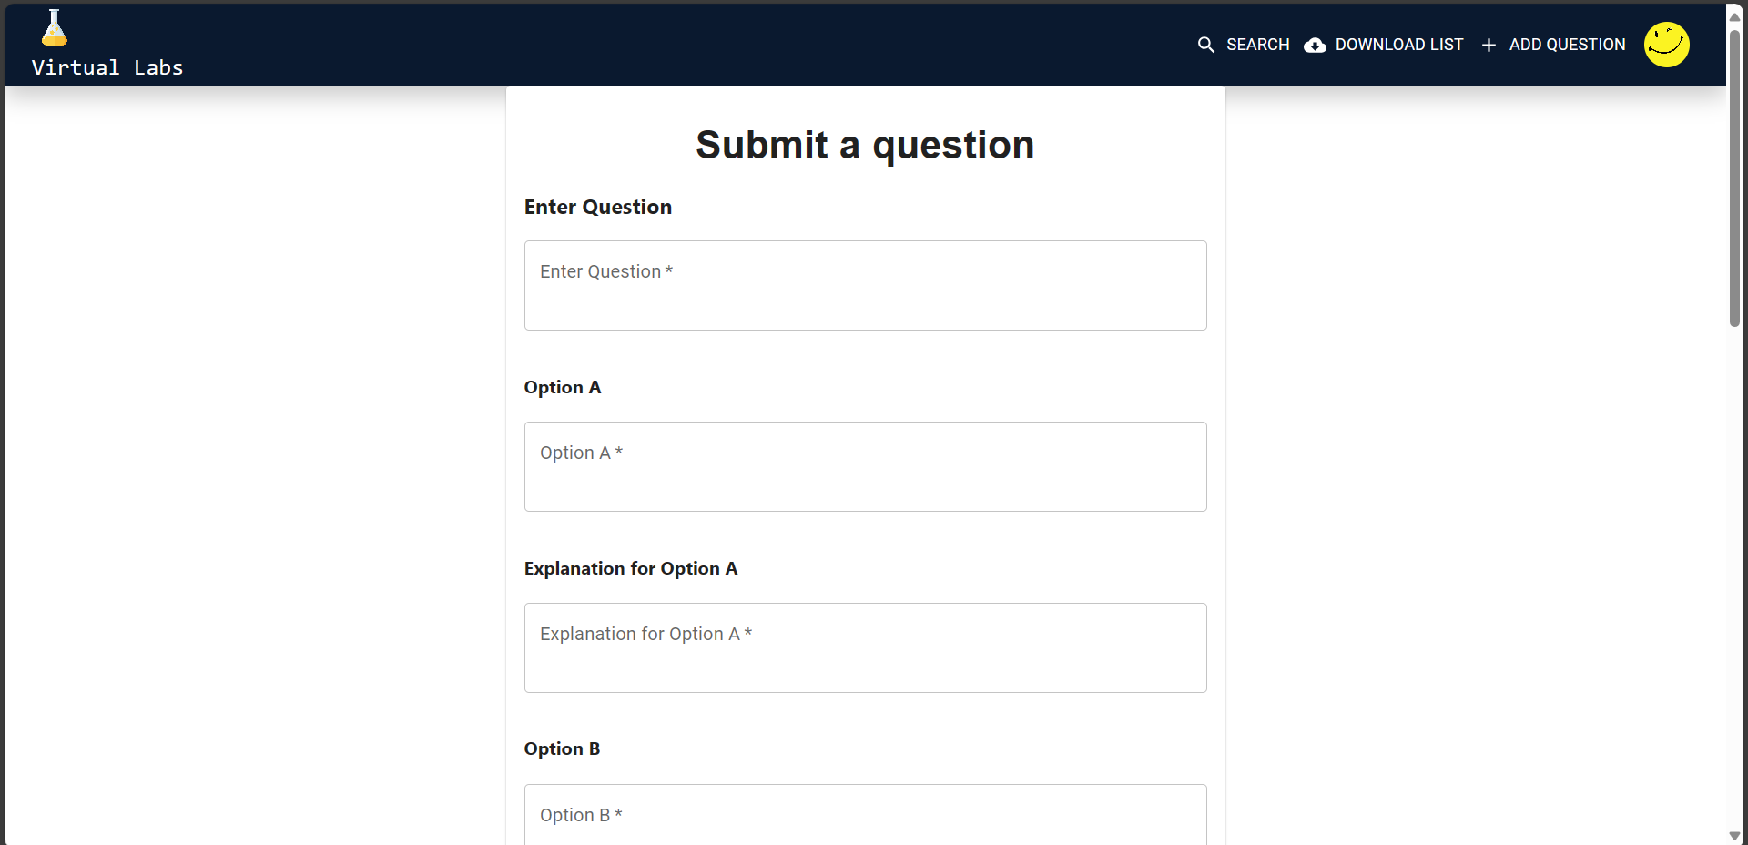
Add Question Page

Slide 12
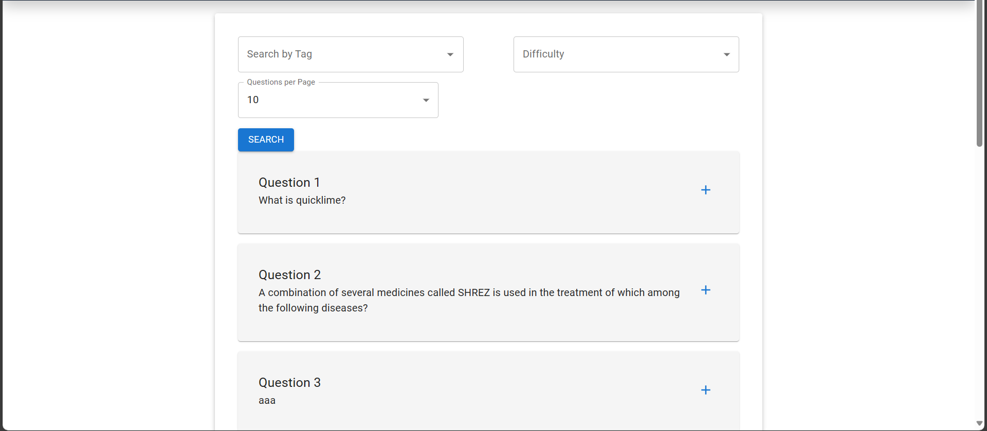
Question Search Screen

Slide 13
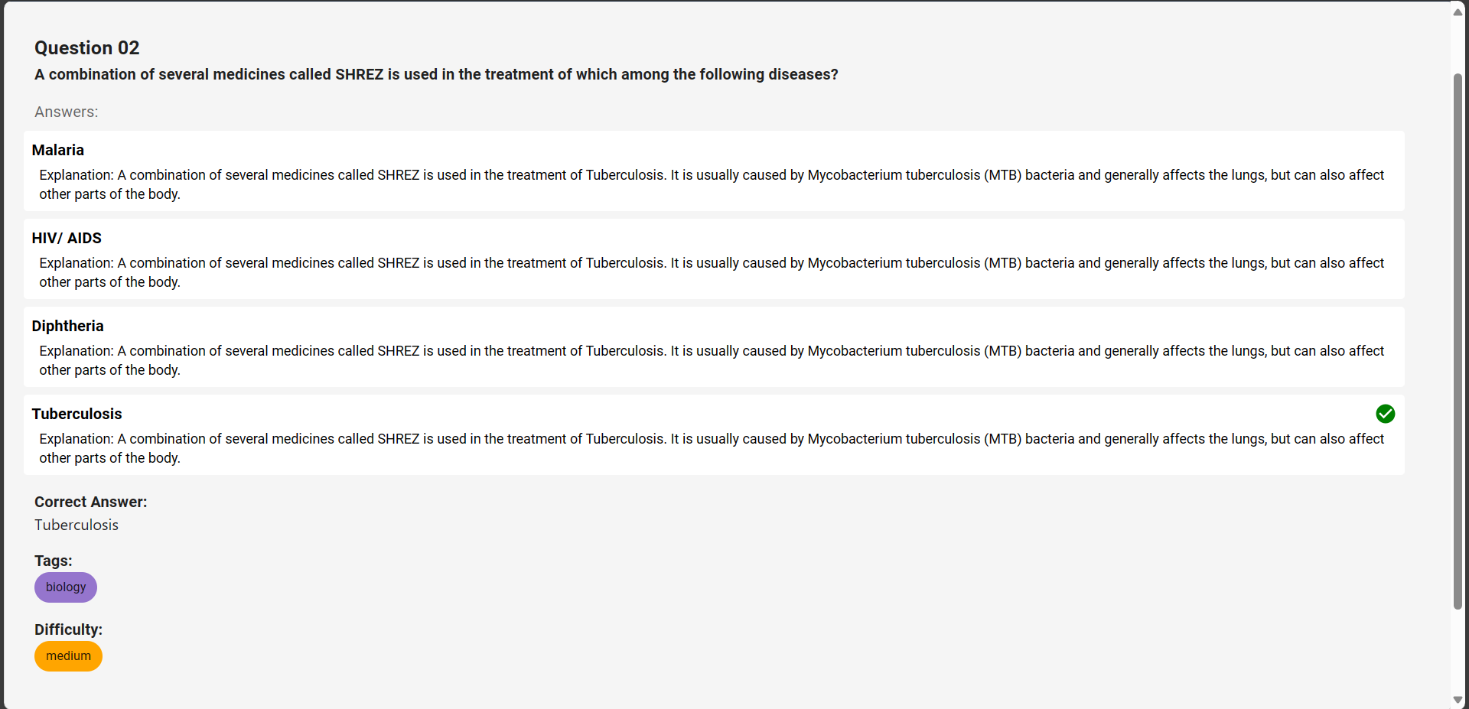
Question Display Screen

Slide 14
Rationale Behind UI Design
Our client mentioned that the users of our application would primarily be students from Tier 2 and Tier 3 colleges. Or teachers / professors having a comparatively less level of computer usage knowledge.
It was also mentioned that the application should be mobile friendly to cater to a larger audience.
We therefore designed our UI to be minimalist and ensured that the core functionality for unhindered learning could be accessed from all the pages and are placed on the top of the page on the Navbar.

Slide 15





Technologies Used
React JS
Firebase
Selenium
.
Express JS

Slide 16

React JS
We are using React (a library of JavaScript) for making the User Interface for our app.
It is a standard stack and was recommended to us by the client.
As most of our code is in JSX (the language used across several web frameworks today), our code is portable in case any frameworks get deprecated in the future.

Slide 17
Firebase
We are using several services from Firebase –
Authentication
Firestore
Hosting
Ours is a serverless application with Firebase being used as a Backend as a Service (BAAS).

Slide 18
Selenium
Automated testing for our app is being done using Selenium – a web automation tool. Selenium aids in automating user input and detecting presence of key features used by pytest to test the functionality being tested.

Slide 19

Pytest
Pytest is a Python testing framework that we are using to test our web application.
Following the test plan.

Slide 20

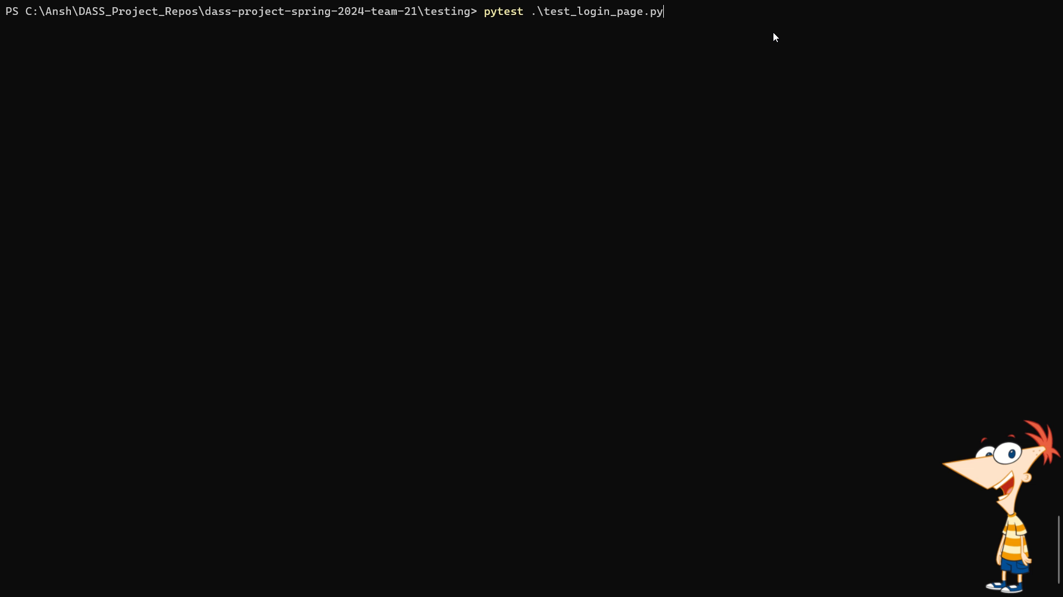
Video of our Web Application

Slide 21
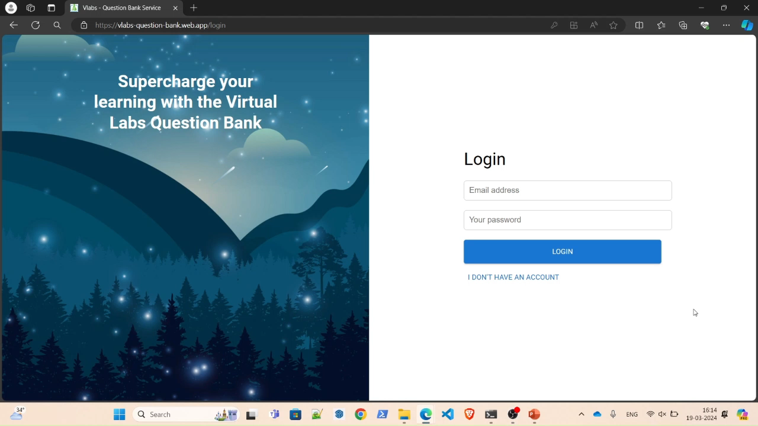

Slide 22
Testing
We have employed automated testing for our web application.
This has been done using Selenium as a web automation tool and Pytest as a python testing framework.

Slide 23
Demo of Automated Testing

Slide 24
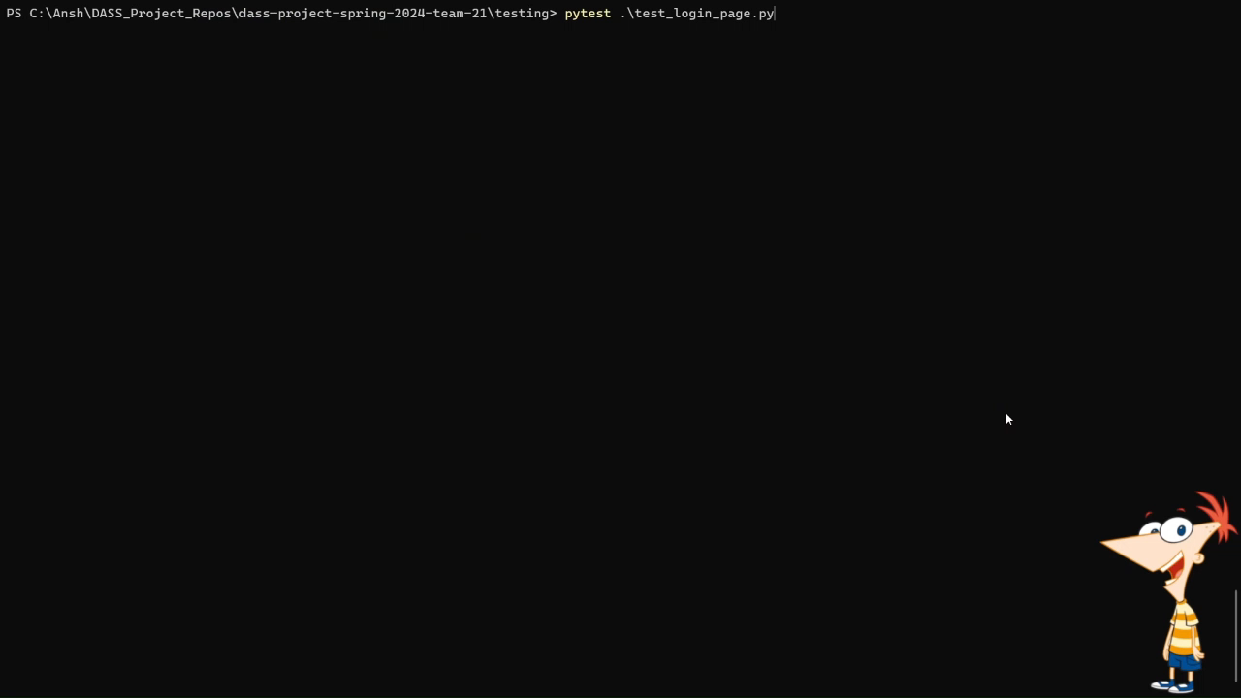

Slide 25
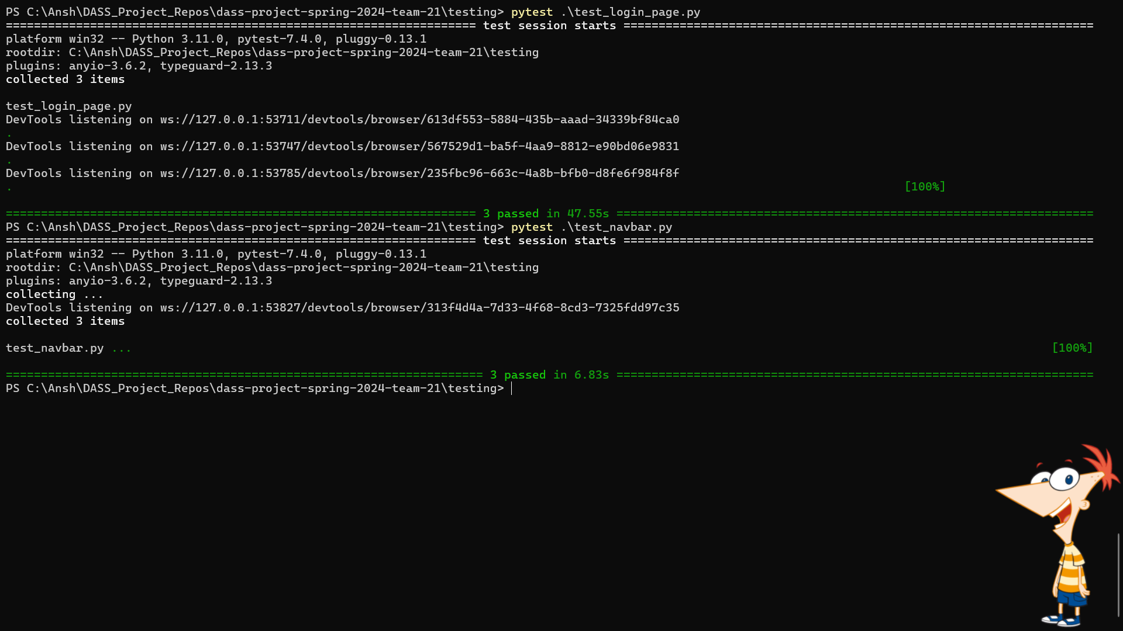

Slide 26
Second round of automated testing

Slide 27
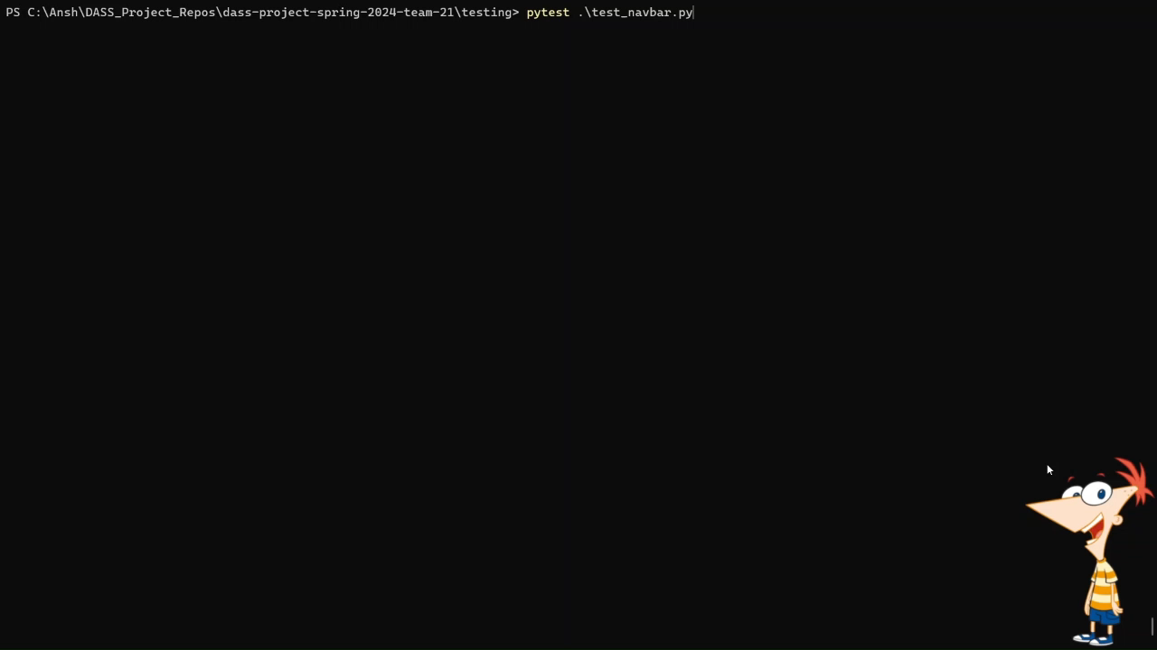

Slide 28
Our app has been deployed and hosted on the web
The Alpha release of our web application has been deployed on the web.
This was done to fulfil the client’s requirement of such a deployment.
Over the course of the past few weeks, we have integrated our application regularly (Continuous Integration) and have deployed the app as soon as we find our integration stable (Continuous Deployment).

Slide 29
Plans for Release-2
Separation of backend to a separate web application.
Image and Markdown Support
Validators and Plagiarism Checker
Credit System
Subject to client’s decision
Super user login + Admin’s CRUD Operations

Slide 30

Issues Encountered
1. Security Issues
Initially when we implemented our login page, we could still go to different pages without logging in. This was fixed by adding different layers to the JSX files to display an access restricted page on such events.

Slide 31

Issues Encountered
2. Initial Integration Problems
Initially when we got started with the project, we faced certain integration issues when all of us were working on different components. This was later fixed by discussing about all the integrable components.
Later we switched to following a process where such a situation might not arise. In this process we segmented out small parts of improvement and pushed it back carefully for each integration / new feature added.

Slide 32
Issues Encountered
.
FRONTEND
3. Separation of the calls to the backend from the frontend to through a middleware app
Our client told us recently that we need separate the backend from the frontend.
This involves removing all direct backend calls from the main app and putting those calls in a separate application. Then interfacing the two apps using a self-made API.
BACKEND

Slide 33
Contributions
---------------------------
---------------------------
---------------------------
---------------------------
Login Page
Signup page
Automated Testing
Solving GitHub Merge Conflicts
Improved UI
Solving Bugs
Documentation
Add Question Backend interface
Question retrieval backend interface.
Update user profile page.
Solving Bugs
Documentation
Search Page
Download Page
Add Question Page
Router Integration.
Solving GitHub Merge Conflicts
Solving Bugs
Documentation
Security – to prevent unauthorized access.
Creating a separate backend
Solving Bugs
Documentation
Ansh Chablani
Divyarajsinh Mahida
Siddharth Singh
Shreyas Badami

Slide 34

Thank you

